Slide 1
Junior High School
Guidance & Counseling Center
Presenting our Guidance Services and Guidance Programs

Slide 2
MYTHS
TRUTHS
We enforce rules and regulations
We inform you about the rules and regulations

Slide 3
MYTHS
TRUTHS
We discipline and or punish students
We guide and help students

Slide 4
MYTHS
TRUTHS
We subjectively judge students and their history
We understand students and listen to their history

Slide 5
MYTHS
TRUTHS
We report every misconduct or violation of students to authorities
We carry out preventive measures and intervention on students’ misconduct

Slide 6
Guidance counselors of today
Gone are the days of school counselors sitting in their office simply handing out college applications, making schedule changes for students who want to drop a class or meeting with the troublemakers in the school.

Slide 7
Guidance counselors of today
Today's school counselors are vital members of the education team. They help all students in the areas of academic achievement, personal/social development and career development, ensuring students to become productive, well-adjusted adults of tomorrow.

Slide 8
GUIDANCE SERVICES

Slide 9
Research and Evaluation
Individual Inventory
Testing Service
Counseling
Career and Placement
Information Service
Follow-up

Slide 10
Individual Inventory
This service pertains to the collection, evaluation and interpretations of data gathered to identify the characteristics and potential of every students that can be used in proper diagnoses, predicting progress and behaviors, accurate placement and program evaluation.

Slide 11
Information Service
To make available certain kinds of information not ordinarily provided through instructional program or during the regular period of instruction/class.

Slide 12
Testing Service
Psychological tests are concerned with your mental and emotional conduct. They can tell you something useful about yourself and the more you know about yourself - your strengths and your weaknesses - the better your chances of making better decisions.

Slide 13
Counseling
Counseling is a goal-oriented relationship between a professionally trained, competent counselor and an individual seeking help for the purpose of bringing about a meaningful awareness and understanding of the self and environment, improving planning and decision making, and formulating new ways of behaving, feeling and thinking for problem resolution and or development growth.

Slide 14
Follow-up Service
Follow up sessions are conducted among students who are counseled, referred by faculty, administrators and other university staff. The follow-up service ensures that the student has learned appropriate behaviors and decisions regarding his/her problem or need.

Slide 15
Career and Placement
Our focus is career education and professional development for our students and alumni. We assist in the development of skills, knowledge, and experiences needed to begin a successful career.

Slide 16
Research and Evaluation
Research is a service-oriented activity conducted to discover new knowledge, to advance current knowledge, and to substantiate theory.
Evaluation is a program-oriented activity that seeks to collect relevant information to determine whether program goals are met in terms of outcomes as basis for the modification and delivery of services.

Slide 17
OTHER GUIDANCE SERVICES

Slide 18
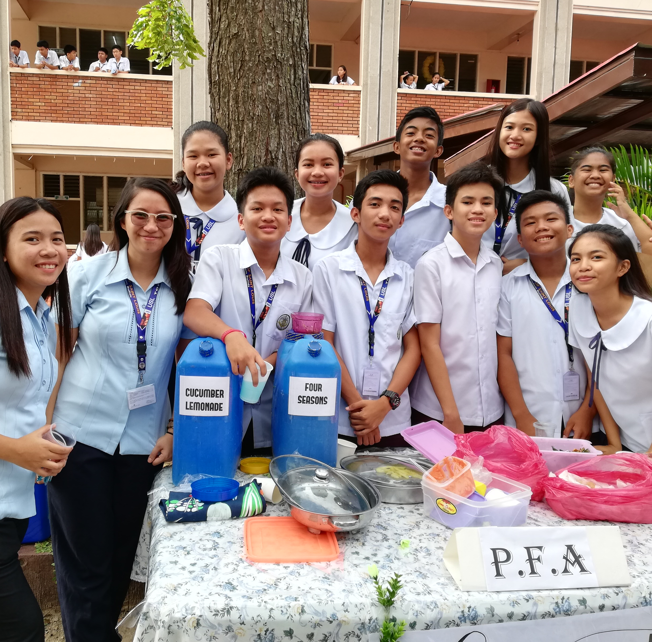
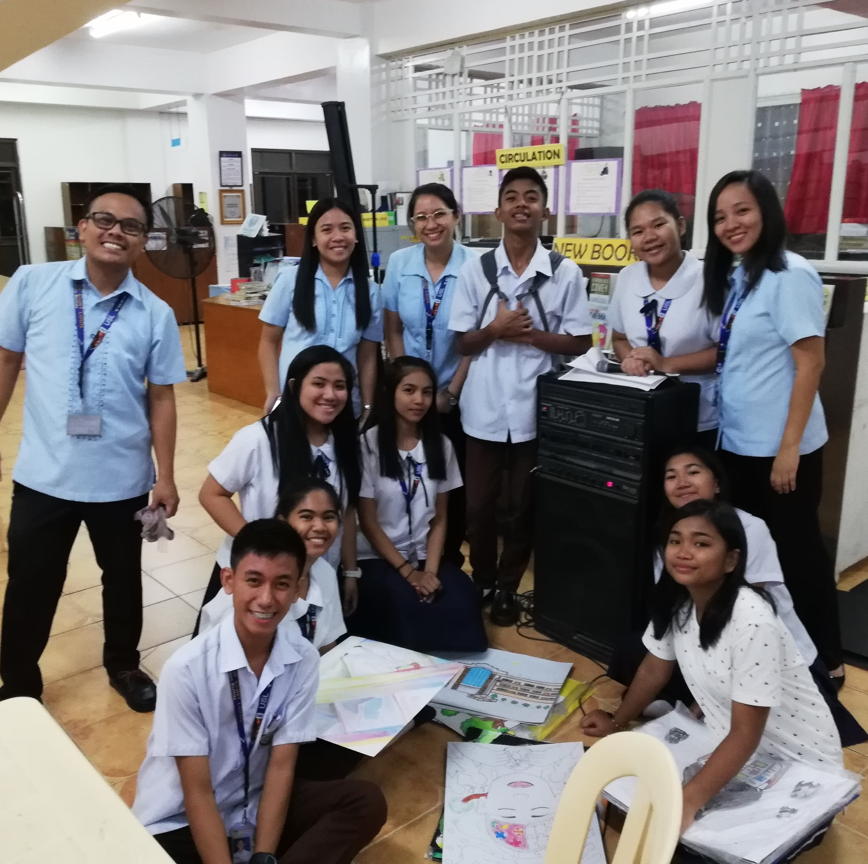
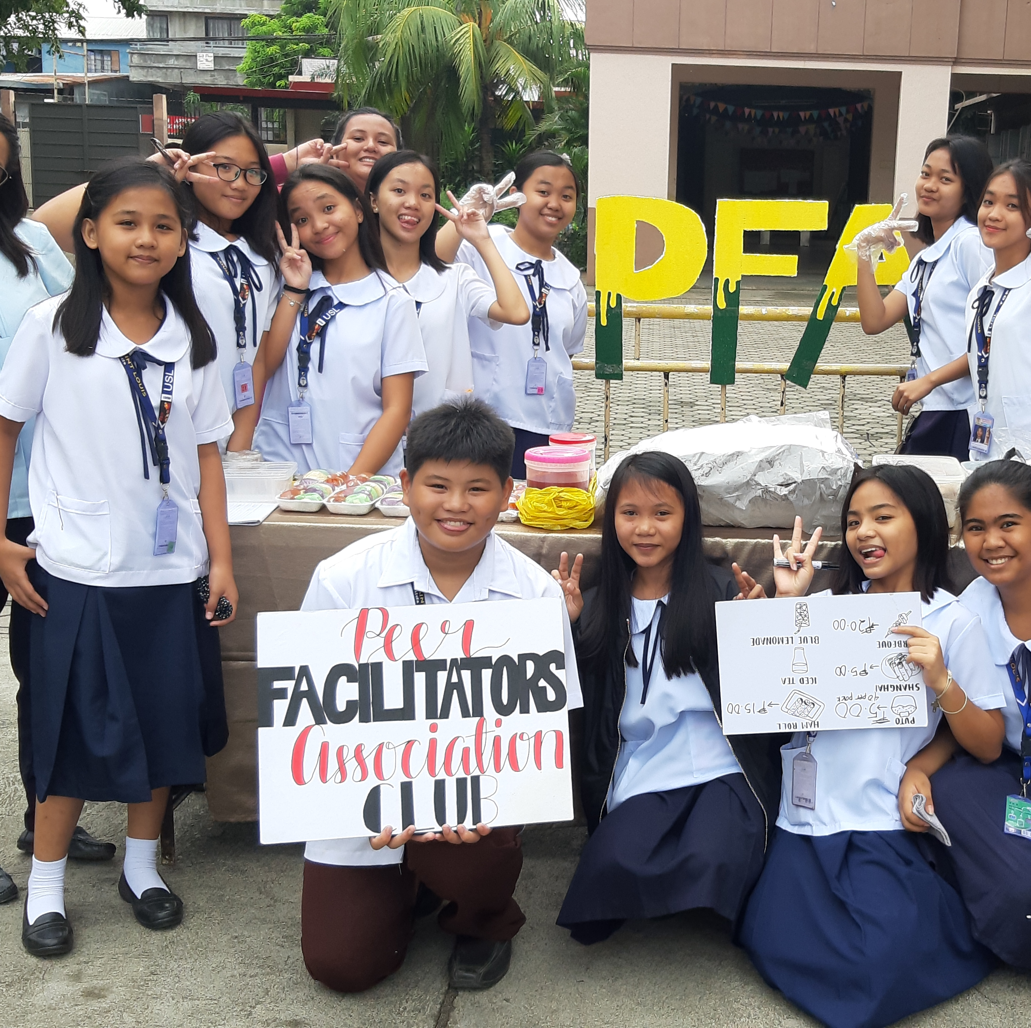
PEER FACILITATORS’ ASSOCIATION
The organization provides opportunities for students to volunteer their services in assisting their peers in developing themselves fully by acting as implementing partners of the guidance staff.

Slide 19
SOCIALIZED ASSISTANCE PROGRAM
Socialized Assistance Program (SAP) is a grant provided by the university for underprivileged but deserving students.

Slide 20
GUIDANCE PROGRAMS

Slide 21
Existing Guidance Programs
www.program
EECL
BEAP
Wise, Well, Win Program
Envisioning and Exploring Career Lifelines
Basic Educational Accession Program

Slide 22
Existing Guidance Programs
HSPAP
RHGP
EOSO
High School Preparedness and Adjustment Program
Revitalized Homeroom Guidance Program
Each One Saves One

Slide 23
Existing Guidance Programs
www.program
EECL
This program emphasizes the capacity of students to make wise or rational choices in order to attain healthy mental and physical functioning that leads to successful lifestyle. This is the prevention and wellness program of the Junior High School Guidance Office of University of Saint Louis.
Career development is a life-long process. In order to help and guide young people in their career path, career education should be a central theme in all schools. The Junior High School Career Guidance is a major component in the development of this theme.

Slide 24
Existing Guidance Programs
BEAP
HSPAP
This program intends to help adjust to the needs and demands of studies by inculcating in the students the values of perseverance, hard work, time management and other related values that will enable them to enhance themselves academically.
The program is designed to extend a helping service to students who have been experiencing adjustment difficulties from primary school to junior high school.

Slide 25
Existing Guidance Programs
RHGP
EOSO
This program is a holistic program which is included in the Junior High School students’ subject curriculum. It aims to accompany the student on the road to self-discovery and maturation. Each module covers a range of topics on adolescent development.
The Each One Saves One program is a scheme to monitor students with failing conduct grade across grade levels through the help of guardian teachers. This program aims to assist students through a gradual progress of adopting effective habits.

Slide 26
NEW Guidance Program
WAGI
Wellness Assistance and Guidance Initiatives

Slide 27
WAGI
The Wellness Assistance and Guidance Initiatives program was designed to provide adequate mental health and psychosocial support to students. This program also paves way to the delivery of various tele-mental health services to all students to help them adjust, cope and overcome the challenging experience during this difficult times.

Slide 28
WAGI SERVICES FOR STUDENTS
01
03
Guidance Helpline
Psychoeducation
Telecounseling
Online Assessment
02
04

Slide 29
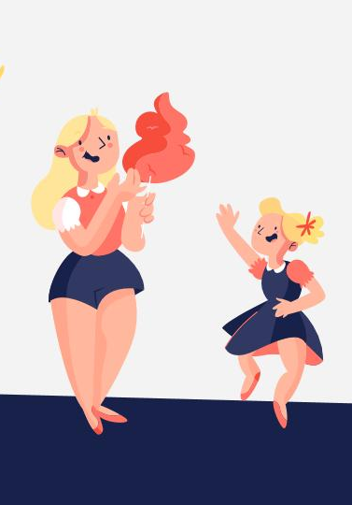
USL GUIDANCE CENTER FACEBOOK PAGE
Online Appointment Form
bit.ly/USLAppointmentForm
Referral Form
bit.ly/USLReferralForm
Louisian Wellness Check
bit.ly/LouisianWellnessCheck

Slide 30
WAGI SERVICES FOR TEACHERS
01
03
Consultation
Telecounseling
Trainings
02

Slide 31

USL GUIDANCE CENTER HOTLINES
ELEMENTARY
0956 307 8717
JUNIOR HIGH SCHOOL
0905 308 5090
SENIOR HIGH SCHOOL
0956 307 8726
COLLEGE
0956 307 8714

Slide 32
Meet the Guidance Counselors

Slide 33
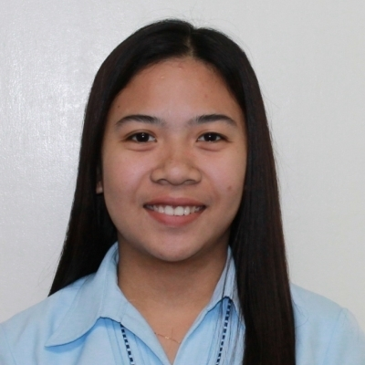
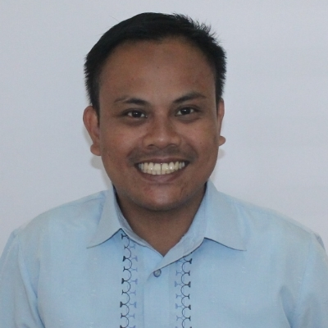
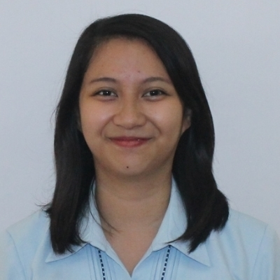
Junior High School Guidance Counselors
Christine Joyce R. Onate
Jenikko L. Quinto
Pauline Alexandra C. Espejo, RPm

